Slide 1

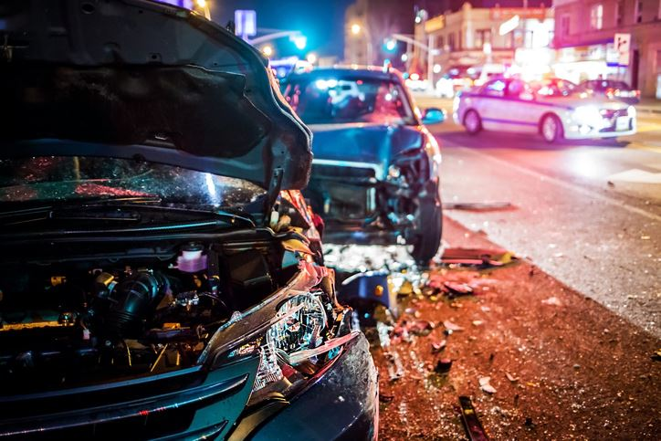
NYC COLLISIONS
Data Analysis
#EDA and Dashboard

Slide 2
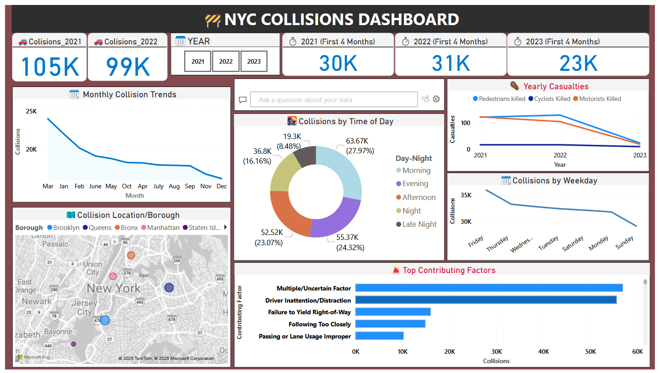
Overview:
The dashboard gives a comprehensive snapshot of NYC traffic safety, identifying high-risk periods boroughs with frequent incidents, and leading causes of collisions.

Slide 3
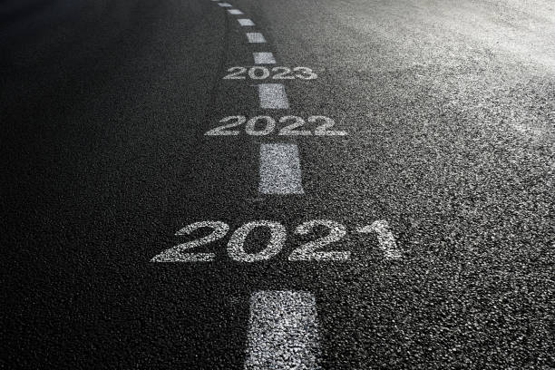
📊 Key Statistics:
2021: 105K collisions
2022: 99K collisions
2023 (First 4 Months): 23K collisions
First 4 Months:
2021: 30K | 2022: 31K | 2023: 23K
Summary:
There’s a consistent decline in total collisions, especially a ~25% drop in early 2023,
**indicating improved traffic control or less road activity post-COVID.

Slide 4

📅 Monthly Collision Trends (2021-2022)
The chart shows a steady decline in collisions from January through December, with March seeing the highest and November–December the lowest.
Summary:
Collisions are more frequent in winter/spring months and taper off towards the end of the year, likely due to changing weather and traffic volumes.
🕒 Collisions by Time of Day:
Evening: 27.97%
Afternoon: 24.32%
Night: 23.07%
Morning: 16.16%
Late Night: 8.48% Summary:
Evenings and afternoons are the riskiest periods, likely due to rush hours and increased vehicle activity. Late night sees the fewest incidents.

Slide 5
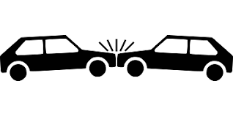
📅 Collisions by Weekday:
*Highest on Fridays
Gradual decrease through the week
*Lowest on Sundays
Summary:
End of the workweek (especially Friday) poses higher collision risks,
**likely due to increased travel and fatigue, while Sundays remain safest.
☠️ Yearly Casualties (2021–2023):
All categories (pedestrians, cyclists, motorists) show a downward trend.
Summary:
Road safety has improved, with declining fatalities, suggesting effective enforcement,
safer infrastructure, or decreased traffic volumes.

Slide 6

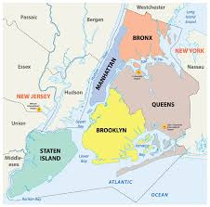
📍 Collision Locations by Borough:
Brooklyn: Highest (Large dark blue bubble)
Queens: Second-highest (Orange bubble),
Manhattan: Moderate (Pink bubble),
Bronx: Moderate (Purple bubble)
Staten Island: Lowest (Light blue bubble)
Summary:
Brooklyn and Queens are NYC’s top hotspots for vehicle collisions.
**Higher population density and traffic congestion may contribute.
Manhattan and Bronx follow,
while Staten Island reports fewer incidents.
Collisions are not evenly distributed across NYC's boroughs.
This geographic insight helps prioritize resource allocation and safety campaigns for high- risk areas.

Slide 7
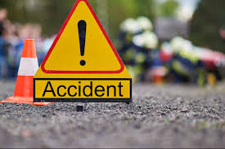
⚠️ Top Contributing Factors:
Multiple/Uncertain Factors – ~60K
**Driver Inattention/Distraction – ~58K
Failure to Yield Right-of-Way
etc.. like Following Too Closely, Improper Passing/Lane Usage
Unsafe Speed, Alcohol Involvement
Summary:
Most crashes result from driver behavior, not external conditions.
Distraction, right-of-way issues, and tailgating are top concerns.
Secondary causes like speeding, alcohol, and fatigue still play notable roles.
For Staten Island, Animals interference on road is also one of the major cause for collisions and road accident casualties.

Slide 8

✅ Conclusive Insights:
🚦 Collisions are decreasing yearly, with a sharp decline in 2023.
🌆 Evenings and afternoons are high-risk periods.
📍 Brooklyn and Queens are hotspots for collisions.
🧠 Most collisions are caused by driver behavior, not external conditions.
📉 Fridays have the highest incidents, Sundays the lowest.
🛑 Fatalities are declining, indicating improved road safety.
Summary:
The city has seen positive trends in safety, but continued efforts are needed to address human factors and borough-specific issues for further reductions.

Slide 9
THANK YOU
~Yashraj Singh
[ yashrajsingh2288@gmail.com ]
GitHub: https://github.com/Yashrajyr1
LinkedIn: https://www.linkedin.com/in/yashrajsingh-/

